Slide 1
INTRODUCTION TO WEB DEVELOPMENT - SESSION 2

Slide 2

Problem solving and decision making
@SEDC 2018-2019

Slide 3


HOW HUMANS SOLVE PROBLEMS
Solve unique complex problems using the brain
Intelligence - Ability to acquire and apply knowledge and skills efficiently
Adapted to pattern matching
Ability to discover and learn for themselves
@SEDC 2018-2019

Slide 4
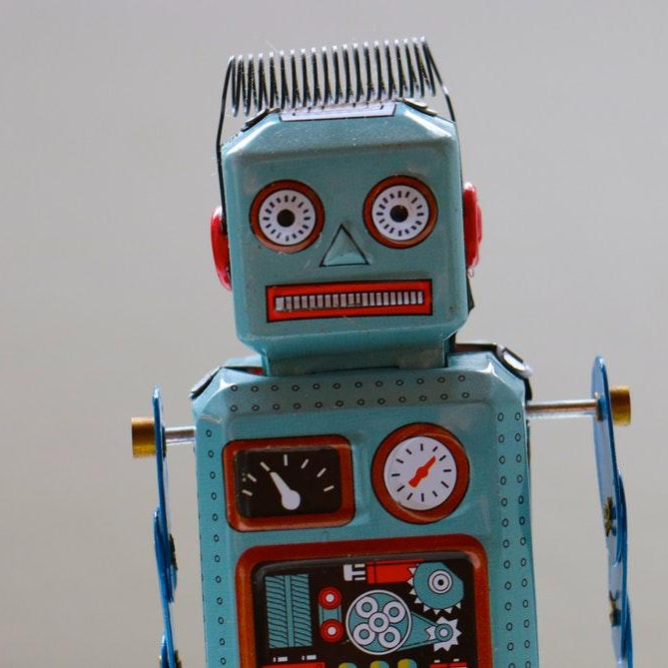
HOW MACHINES SOLVE PROBLEMS
Using processor to process information
Only solves problems it was intended to solve
Can only solve problems with very low complexity
Can solve multiple problems extremely fast
@SEDC 2018-2019

Slide 5
HUMANS VS COMPUTER TASK
Find five things where humans outmatch computers in the real world Find five things where computers outmatch humans in the real world
Time to complete: 10 - 15 minutes
@SEDC 2018-2019

Slide 6
Humans outmatch computers
Unstructured problem-solving: solving for problems in which the rules do not currently exist. Examples: a doctor diagnosing a disease, a lawyer writing a persuasive argument, a designer creating a new web application.
Acquiring and processing new information, deciding what is relevant in a flood of undefined phenomena. Examples: a scientist discovering the properties of a medicine, an underwater explorer, or a journalist reporting on a story.
Nonroutine physical work. Performing complex tasks in 3-D space, from cleaning to driving to cooking to giving manicures, which is thought of as relatively low-skilled work for humans, but actually requires a combination of skill #1 and skill #2 that is still very difficult for computers to master.
Being human: Expressing empathy, making people feel good, taking care of others, being artistic and creative for the sake of creativity, expressing emotions and vulnerability in a relatable way, making people laugh. The human touch is indispensable for most jobs, and in some cases, it is the entire job. In this one, humans win.

Slide 7
LETS DECOMPOSE A SOLUTION
How did you get to SEDC, today?
Do it as atomically as possible
Include every logical decision
Time to complete: 10 - 15 minutes
@SEDC 2018-2019

Slide 8

But what is programming?
@SEDC 2018-2019

Slide 9
WHAT IS PROGRAMMING
The process of writing a sequence of instructions (algorithms) with a chosen language to be executed by a computer
Part of the process for creating software and applications
The process of implementing solutions by writing code
@SEDC 2018-2019

Slide 10
INSTRUCTIONS AND ALGORITHMS
The sequence of instructions used to solve a specified problem in a finite amount of time with finite amount of data
Written (or verbal) description of logical sequence of actions, applied to specific objects
@SEDC 2018-2019

Slide 11
PROGRAMMERS AND WHAT THEY DO
They solve problems
The programmer program by analyzing the problem, breaking it into manageable parts (“divide and conquer” rule), and creating a general solution for each piece called algorithm
Computer problems could be only one set of logical instructions (one algorithm), but sometimes they can be combined (multiple sets of logical algorithms) to solve certain problem
They create software programs
Complex software programs could be consisted of thousands or millions of algorithms that all together solve a lot of problems through automation and therefore creating intelligence
@SEDC 2018-2019

Slide 12
VIRTUES OF A PROGRAMMER (Admirable Qualities)
Hubris (Overbearing pride or presumption)
Excessive pride (self-respect) that drives programmers to create quality programs, go back and make them better and strive to create great pieces of software
Impatience
“Do it right away” attitude and restlessness, that drives programmers to perfect their code and write programs that other people will enjoy using
Laziness
The power to make the computer do work instead of you and the ability to work less but efficient rather than more and inefficient.
Endurance
An ability to go through seemingly impossible situations, test code over and over again and create robust and reliable programs
Perseverance (Persistent determination)
A virtue that drives programmers to invest energy and focus on a difficult problem for a prolonged amount of time and sometimes do the computers work to show that it’s wrong
Humility
A quality that makes us recognise great things and use them if they are superior to our solutions, ask stupid questions and ultimately become better programmers
@SEDC 2018-2019

Slide 13
OUR GOAL
To be able to solve complex problems by writing complex software applications
@SEDC 2018-2019

Slide 14
PROGRAMMING LANGUAGES
Programming language is a formal language designed to communicate instructions to a machines, particularly a computer
Programming languages are used to create programs and control the behavior of the machines
Programming languages are the way how we ‘talk’ to Computers – and sometimes to each other
@SEDC 2018-2019

Slide 15
WHAT IS A PROGRAMMING LANGUAGE MADE OF?
Syntax
The text of the language, the reserved keywords that create the structure and rules of the language. It’s a textual representation of the instruction that we give.
What is “x”. Where do we put ; What code do we enclose in { }
Semantics
The meaning of the language and its features. It is what creates limits and logic behind the text and the structure.
Is “x” a type that holds numbers? If so how many numbers can it store?
@SEDC 2018-2019

Slide 16
LOW LEVEL PROGRAMMING LANGUAGES
Languages close to the machine
Machine languages are the natural languages of the computers. Instructions are set of 1s and 0s
Assembly languages are one level above machine languages and are usually consisted of simple and crude syntax
@SEDC 2018-2019

Slide 17
HIGH LEVEL PROGRAMMING LANGUAGES
High-level languages allow programmers to write programs which are very similar to the natural English language
They were developed to speed-up the process of developing computer programs
The code written in these languages is called source code
@SEDC 2018-2019

Slide 18
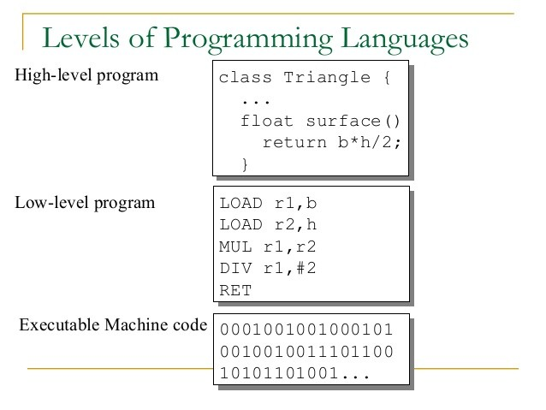
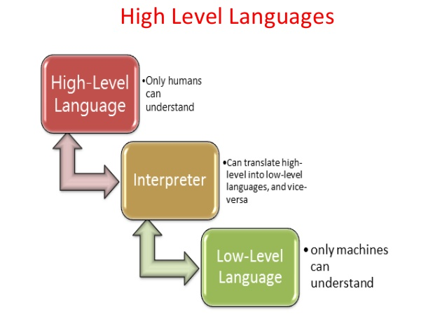
High vs. Low –level languages

Slide 19
PROGRAMMING LANGUAGES CATEGORIES
Low Level
High Level
Assembly
C
C#
PYTHON
Pseudo Code
Machine Code
English Grammar
@SEDC 2018-2019

Slide 20
THE WHOLE PICTURE
C = A + B
High Level Language ( JAVA, C#, C++ )
ADD A, B
Assembly Language ( Low Level with abstraction )
100100111
Machine Language ( Low Level without any abstraction )
@SEDC 2018-2019

Slide 21
LET’S TRY SOMETHING
Open http://lightbot.com/hour-of-code.html
It’s a simple game that simulates commands and a robot that follows them to the letter
Let’s try and go through some solutions together
@SEDC 2018-2019

Slide 22

Time for questions!
@SEDC 2018-2019

